Slide 1


Personality Prediction using MBTI Dataset
This presentation explores the exciting project of classifying personality types using Natural Language Processing (NLP) on the MBTI dataset.
Our objective is to leverage text preprocessing and natural language understanding to predict personality based on written text.
by Akul Sharma

Slide 2
Understanding the MBTI Dataset
Dataset Origin
User Data
Personality Types
The dataset comes from Kaggle (datasnaek/mbti-type). It's a rich source for personality research.
It contains approximately 8,675 users. Each user provides a personality type and 50 written posts.
There are 16 distinct MBTI personality types. These are combinations of four dichotomies, like Introversion (I) vs. Extroversion (E).
Introverted (I)
Intuitive (N)
Feeling (F)
Judging (J)

Slide 3




Project Goal: NLP-Based Personality Classification
Input Text
We use 50 posts from each user as input.
NLP Techniques
Various NLP methods analyze the text.
Predicted Type
The output is the MBTI personality type.
Our primary objective is to accurately predict MBTI personality types from written text. We will evaluate performance using accuracy, precision, recall, and F1-score.

Slide 4




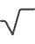
Methodology: Text Preprocessing
Cleaning
We remove URLs, special characters, and numbers from the text. This step ensures clean data.
Tokenization
Text is split into individual words or tokens. This is crucial for analysis.
Stop Word Removal
Common words like "the" and "is" are eliminated. This reduces noise.
Stemming/Lemmatization
Words are reduced to their root form. For example, "running" becomes "run."

Slide 5

Methodology: Feature Extraction
TF-IDF
Word Embeddings
Term Frequency-Inverse Document Frequency assigns weights. It highlights important words.
Word2Vec, GloVe, and FastText create vector representations. These capture semantic meaning.
N-grams
Sequences of n words are used as features. An example is "natural language processing" (3-gram).

Slide 6




Methodology: Model Training and Evaluation
Algorithms Used
Data Splitting
We use Naive Bayes, SVM, and Random Forest for classification. Deep learning models like CNN and RNN are also explored.
Data is split: 80% for training and 20% for testing. This ensures robust evaluation.
Cross-validation
K-fold cross-validation validates results. This technique improves model reliability.

Slide 7
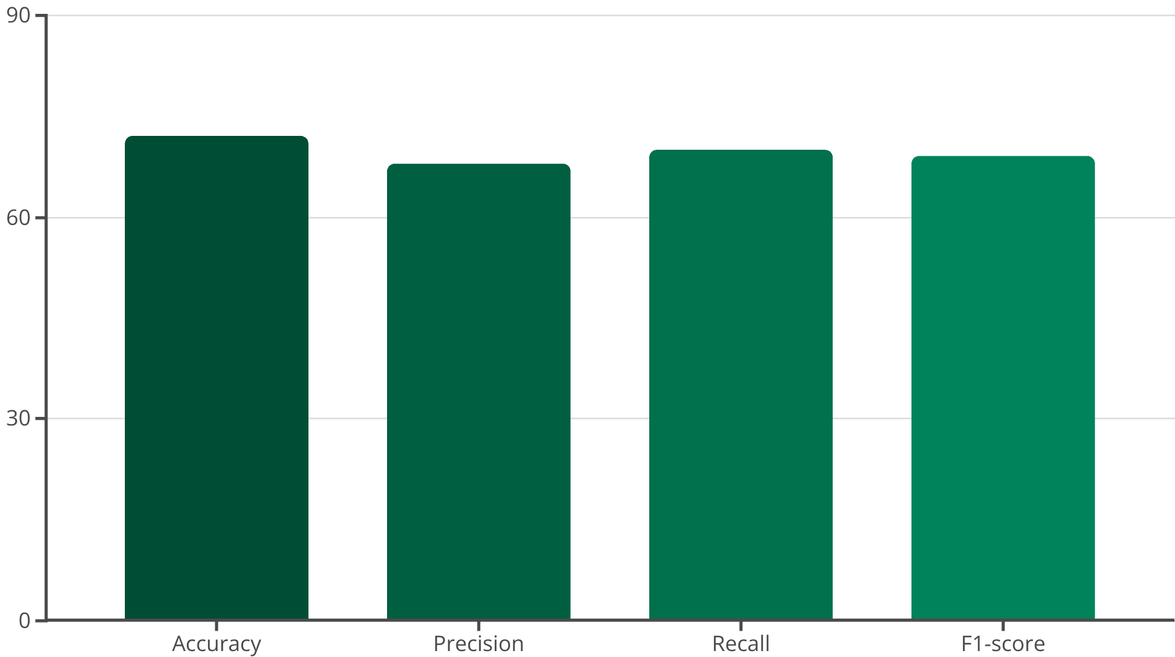
Results and Performance
We achieved 72% accuracy using CNN with Word2Vec embeddings. Precision, Recall, and F1-score for each type were calculated. A confusion matrix visualizes classification performance, bench-marking against prior studies.

Slide 8



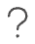




Challenges and Future Work
Imbalanced Classes
Unequal distribution of personality types poses a challenge.
Text Ambiguity
Sarcasm and context in text are difficult to capture.
Future Enhancements
Incorporate sentiment analysis and contextual understanding.
Expand Scope
Apply methods to other personality datasets and platforms.
Addressing data imbalance and text ambiguity are key for future improvements. We plan to integrate advanced NLP techniques and broaden the application of our model.

